Slide 1
UCF439 Capstone Project Face Detection and Recognisation Mode A Group No. 48,
Under the Supervision of:
Dr. Naveen Kumar
Supervisor Email:
naveen.kumar@dituniversity.edu.in
SATYAM RAJ (1000015607)
RISHAV KUMAR (1000014613)
DHANRAJ KUMAR (1000014261)
B.Tech CSE

Slide 2
TABLE OF CONTENTS
S.No | Title | Page No.
1 | Introduction | 3
2 | Project Objective | 4
3 | Training stages | 5-6
4 | Methodology | 7-9
5 | Feasibility Studies | 10-11
6 | Models | 13
7 | Calculations | 14-15
8 | Timeline | 16-17
9 | References | 18-19

Slide 3
INTRODUCTION - GENDER PREDICTION
Gender identification refers to the process by which individuals recognize and categorize the gender of themselves or others. It involves the internal sense of one's own gender identity as well as the perception and interpretation of gender cues in others.
Gender prediction using facial biometrics involves the use of technology, particularly facial recognition algorithms and machine or deep learning models, to analyze and infer the likely gender of an individual based on their facial features.
GENDER PREDICTION
MALE
FEMALE

Slide 4
Project Objective
Building a deep learning model using convolutional neural networks (CNNs) to predict age and gender from facial images.
Utilizing the UTKFace dataset, a comprehensive collection of annotated facial images, for model training and evaluation.
Evaluating the performance of the trained model on test data and assessing its accuracy in age and gender prediction tasks.

Slide 5
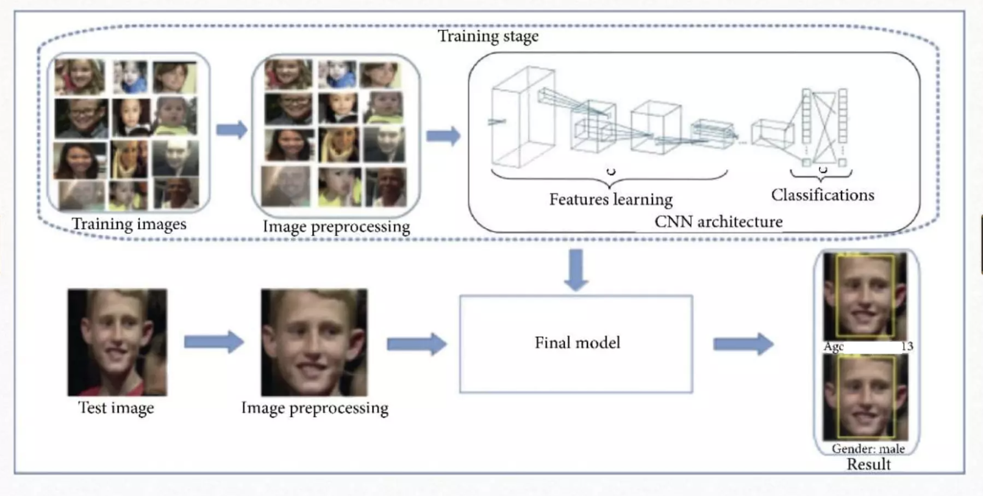
Training Stages

Slide 6
UTKFace DataSet
The UTKFace dataset is a comprehensive collection of facial images curated specifically for age and gender recognition tasks.
It contains over 20,000 images of human faces, annotated with age, gender, and ethnicity information.
Each image in the dataset is labeled with the person's age, ranging from 0 to 116 years old.
Gender is classified as male or female, providing a binary classification for gender prediction tasks.

Slide 7
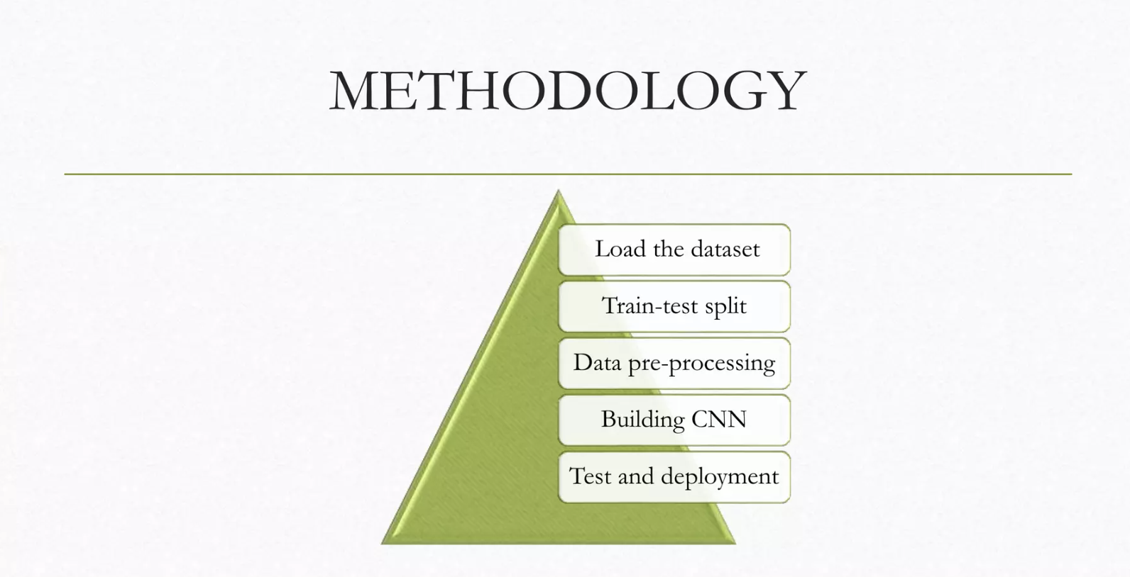
METHODOLOGY

Slide 8
Data Loading and Preprocessing:
loaded images from the UTKFace dataset, preprocess them, and extract age
and gender labels from the filenames.
2. Data Visualization:
visualized the distribution of ages in the dataset using a histogram.
3. Model Construction:
define a CNN model using Keras functional API. The model takes grayscale
images of size 64x64 as input and predicts both age and gender.
4. Model Training:
compiled the model with appropriate loss functions and metrics for both age
and gender prediction. Then train the model using the training data and
validate it using the testing data.
5. Model Evaluation and Visualization:
visualize the training and validation loss over epochs to monitor the model’s
performance. Finally, you save the trained model.
6. Inference and Visualization:
provide functions to make predictions on new images using the trained model and
visualize the results.

Slide 9
FEASIBILTY STUDY - ECONOMICAL
The economic feasibility of gender prediction using facial biometrics depends on several factors, including:
Development Costs:
In-house development: Requires skilled data scientists and engineers, leading to high salaries and potential infrastructure costs.
Pre-trained models and APIs: Can reduce development time and costs but incur licensing fees.
Data Acquisition:
Public datasets: Free to use, but might not be diverse or well-suited for specific applications.
Private datasets: Require licensing or data collection efforts, which can be expensive.
Computational Resources: Training deep learning models often necessitates powerful GPUs or cloud platforms, incurring ongoing costs.

Slide 10
FEASIBILTY STUDY - OPERATIONAL
Operational feasibility refers to the practicality of implementing and using gender prediction with facial biometrics in real-world scenarios.
Technical Requirements:
Hardware: Facial recognition systems require cameras with good resolution and potentially specialized hardware for deep learning inference, especially for real-time applications.
Software: The chosen deep learning framework needs to be compatible with the deployment environment (cloud, edge devices).
Computational Resources: For real-time processing, the system must have sufficient processing power (CPUs, GPUs) to handle image analysis and prediction within acceptable timeframes.
Deployment Considerations:
System Integration: The system needs to integrate seamlessly with existing infrastructure (cameras, access control systems).
Network Connectivity: Reliable internet connection is often required for communication with cloud-based training/inference or real-time data processing.
Scalability: The system should be scalable to accommodate future growth in user base or data volume.

Slide 11
MOTIVATION
Research Purposes: Understanding how facial features correlate with gender could contribute to scientific research in different fields.
Identity Verification: Gender prediction might have applications in identity verification systems, particularly where gender verification is necessary for legal or administrative purposes.

Slide 12
WORKING ON MODELS
KNN
LOGISTIC REGRESSION
LINEAR REGRESSION
DECISION TREE
RANDOM FOREST
PREDICT
CLASSIFY
CNN
CAFFE
KERAS

Slide 13
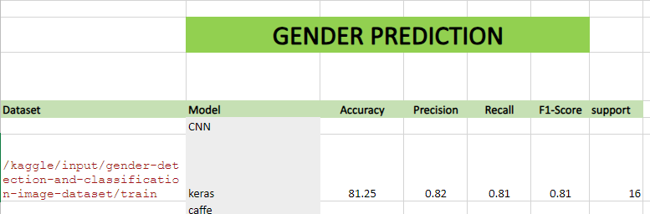
CALCULATIONS

Slide 14
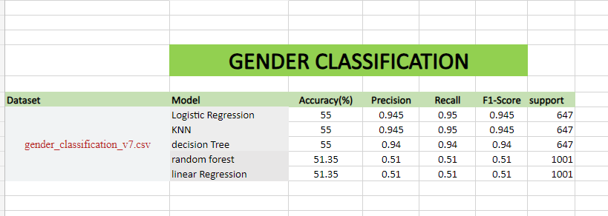
CALCULATIONS

Slide 15
WORK DONE
1. Dataset used: UKT Faces from Keggle
2. Studied about models – their advantages, disadvantages, mathematical formula, example
3. Code
4. Calculate confusion matrix
5. Find: accuracy, recall, precision, f1-score
6. Ppt on: deep learning concepts and models
7. Literature review
WORK TO BE DONE
Improve accuracy of models
2. Testing using other models & their comparision

Slide 16
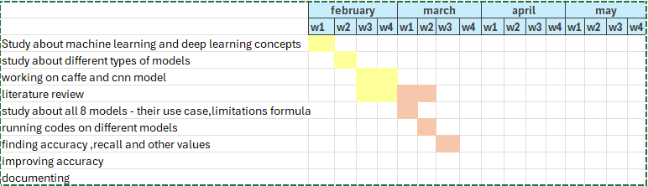
TIMELINE

Slide 17
REFERENCES
[1] Paul Viola and Michael J Jones. Robust real-time face detection. International journal of computer vision, 57(2):137–154, 2004.
[2] Savas, Burcu Kir, Sumeyya Ilkin, and Yasar Becerikli. "The Realization of Face Detection and Fullness Detection in Medium by Using Haar Cascade Classifiers." 2016 24th Signal Processing and Communication Application Conference (SIU), 2016. doi:10.1109/siu.2016.7496215.
[3] Rath, Subrat Kumar, and Siddharth Swarup Rautaray. "A survey on face detection and recognition techniques in different application domain." International Journal of Modern Education and Computer Science 6.8 (2014): 34
[4] Hatem, Hiyam, Zou Beiji, and Raed Majeed. "A survey of feature base methods for human face detection." International Journal of Control and Automation 8.5 (2015): 61-78
[5] E. Alajrami, H. Tabash, Y. Singer and M. Astal, "On using AI-Based Human Identification in Improving Surveillance System Efficiency", 2019 International Conference on Promising Electronic Technologies (ICPET), 2019. Available: 10.1109/icpet.2019.00024 [Accessed 4 June 2020].
[6] Bhattacharya, Jhilik, et al. "Real-time DNN-based Face Identification for the Blind." International Conference on Applications in Electronics Pervading Industry, Environment and Society. Springer, Cham, 2017.
[7] N. Chauhan, "Predict Age and Gender using Convolutional Neural Network and openCV", Medium, 2020. [Online]. Available: https://towardsdatascience.com/predict-age-and-gender-usingconvolutional-neural-network-and-opencv-fd90390e3ce6. [Accessed: 05- Jun- 2020].
[8] Liao, Haibin, et al. "Age estimation of face images based on CNN and divide-and-rule strategy." Mathematical Problems in Engineering, 2018
[9] Uricár, Michal, et al. "Structured output svm prediction of apparent age, gender and smile from deep features." Proceedings of the IEEE Conference on Computer Vision and Pattern Recognition Workshops. 2016.
[10] O. Agbo-Ajala and S. Viriri, "Face-Based Age and Gender Classification Using Deep Learning Model", Image and Video Technology, pp. 125-137, 2020.

Slide 18
BACKGROUND/RELATED WORK-REFERENCES
[1] Shaban, S., Singh, R. P., & Mehra, Dr. M. (2022). Age and Gender Prediction using Caffe Model and OpenCV. International Journal of Innovative Research in Computer Science & Technology, 15–21.
[2] AMA Nada, E Alajrami, AA Al-Saqqa… - Int. J. Acad. Eng. Res …, 2020 - academia.edu
[3] Shaban, S., Singh, R. P., & Mehra, Dr. M. (2022). Age and Gender Prediction using Caffe Model and OpenCV. International Journal of Innovative Research in Computer Science & Technology, 15–21. https://doi.org/10.55524/ijircst.2022.10.1.4
[4] Al-Azzawi, D. S. (2019). Human Age and Gender Prediction Using Deep Multi-Task Convolutional Neural Network. Journal of Southwest Jiaotong University, 54(4). https://doi.org/10.35741/issn.0258-2724.54.4.11

Slide 19
THANK YOU

